Slide 1

BI Mini Project Zomato Restaurant Rating Analysis
Shrushti Mahesh Patil
Shreya Satish Herwade
Komera Chaitanya Sravanthi
Sampriti Dhal
Komal

Slide 2
Objective of the Project
Development of a Zomato Restaurant Rating Analysis.

Slide 3
Abstract of the Project
The culinary in India is as varied as its culture. On every 10 kilometers of distance we find the variety in food. With increasing technology we order food online. Amongst all the food applications Zomato is one which is very widely used.
The purpose of this project is to analyze which restaurant is popular in a particular locality of a particular city. It collects the data on various attributes like City, Cuisines, rating in number, rating in text, Average cost of two person, availability of table and online booking. There are 13 prime cities of India, 226 restaurants with 28 different cuisines spread across 137 different localities of these cities.

Slide 4
Technology Used
Oracle 11G (Database)
Talend Studio (ETL Tool)
MS-Excel (Reporting Tool)

Slide 5
Project flow
EXTRACT
REPORT
Heterogeneous Sources i.e. operational data (Flat files)
TRANSFORM
Data warehouse (Oracle)
Reports Based On Analysis
LOAD

Slide 6
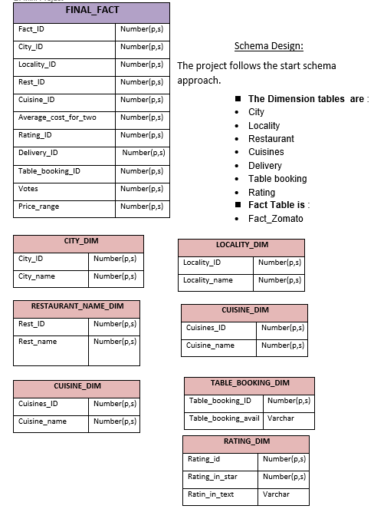
JOBS & REPORTS : FACT TABLE & DIMENSION TABLES

Slide 7
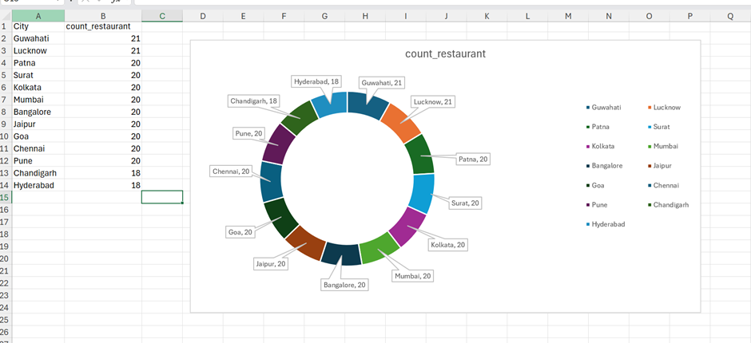
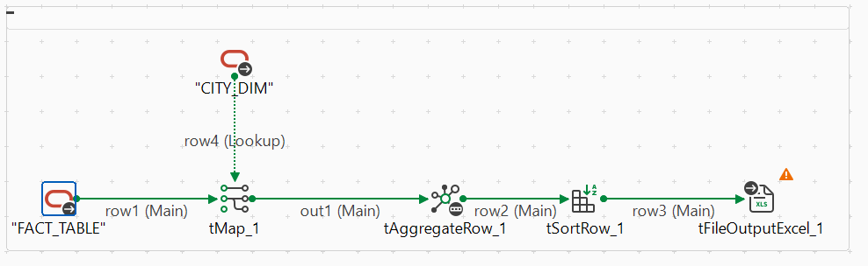
1. Doughnut chart representation for count of Restaurant city wise

Slide 8
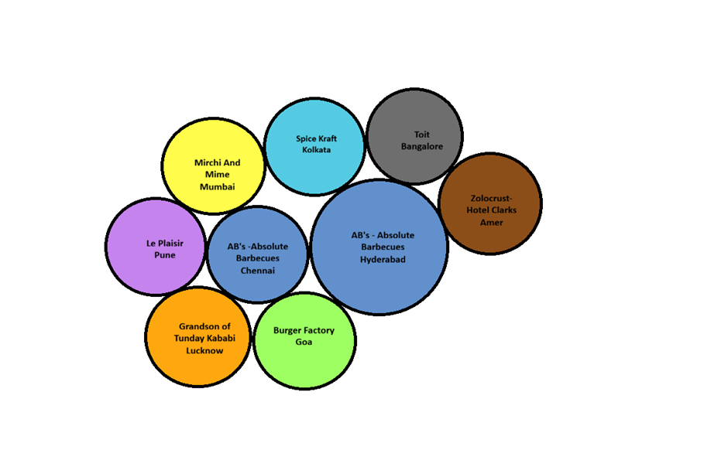
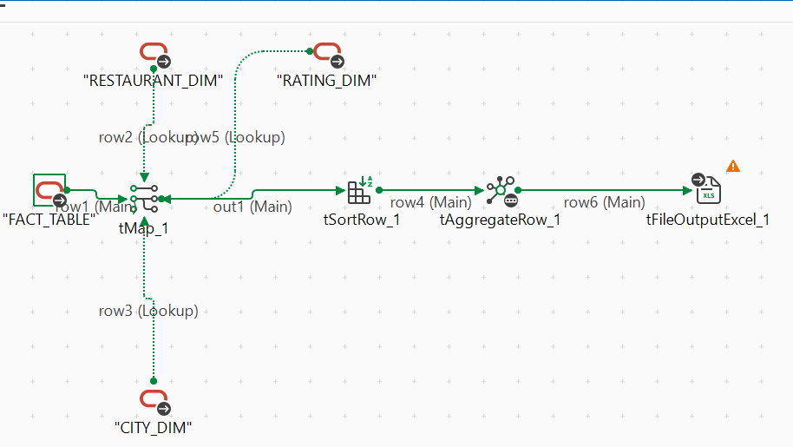
2. Top Restaurant based on Rating City wise

Slide 9
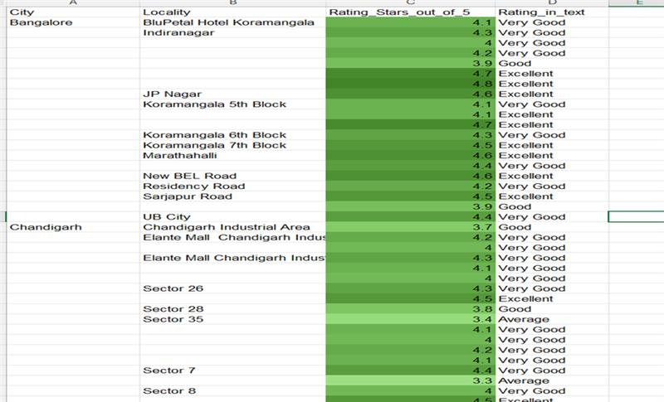
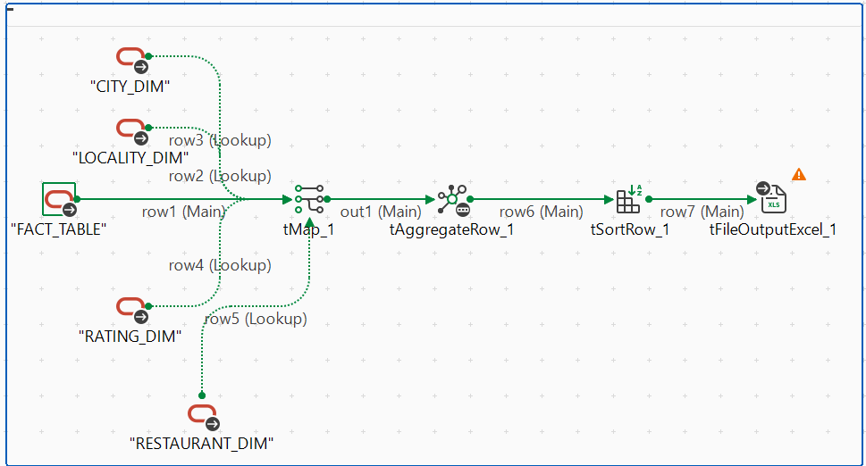
3. Avg Restaurant’s Rating based on City & Locality

Slide 10
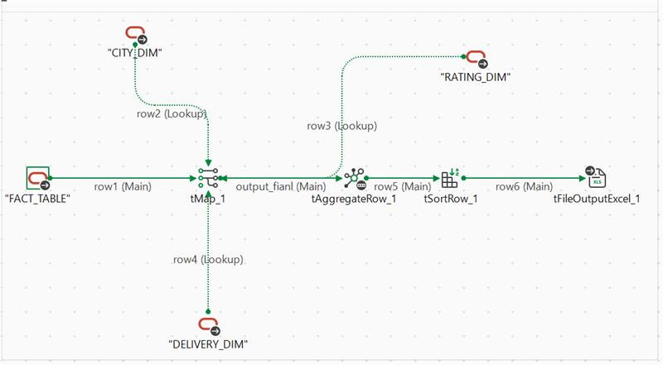
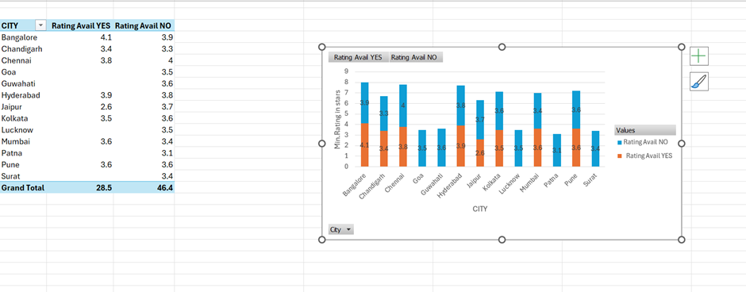
4. Rating based on delivery availability City wise

Slide 11
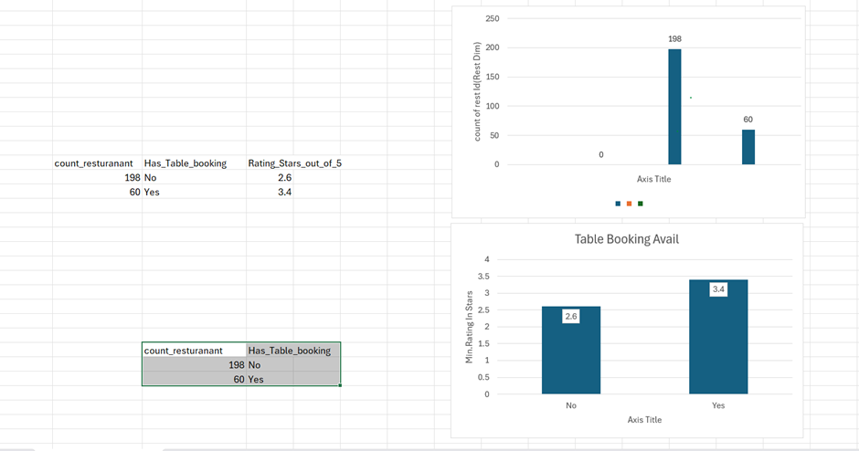
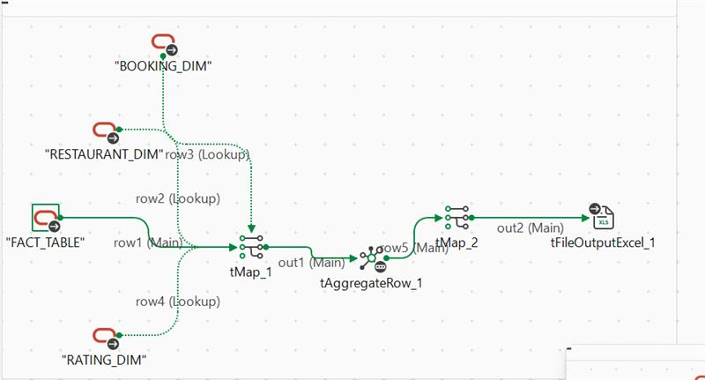
5. Minimum Rating & Count of Restaurant based on Table Booking Availability

Slide 12
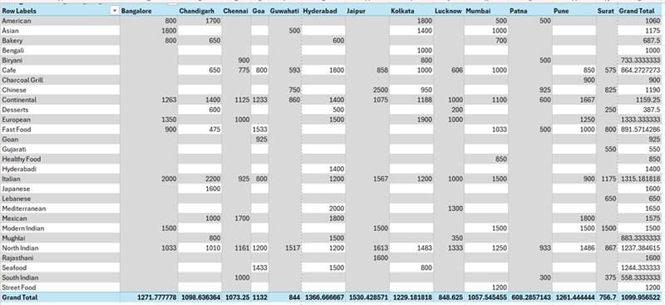
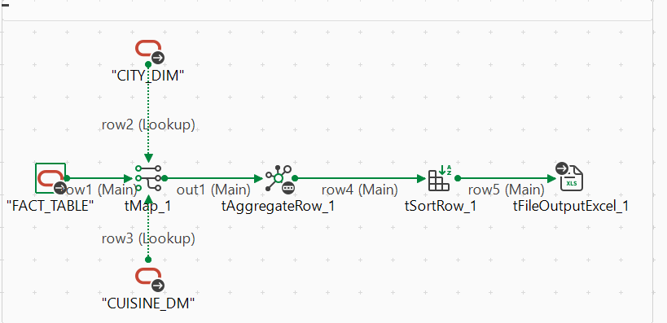
6. Avg cost for two based on Cuisine city wise

Slide 13
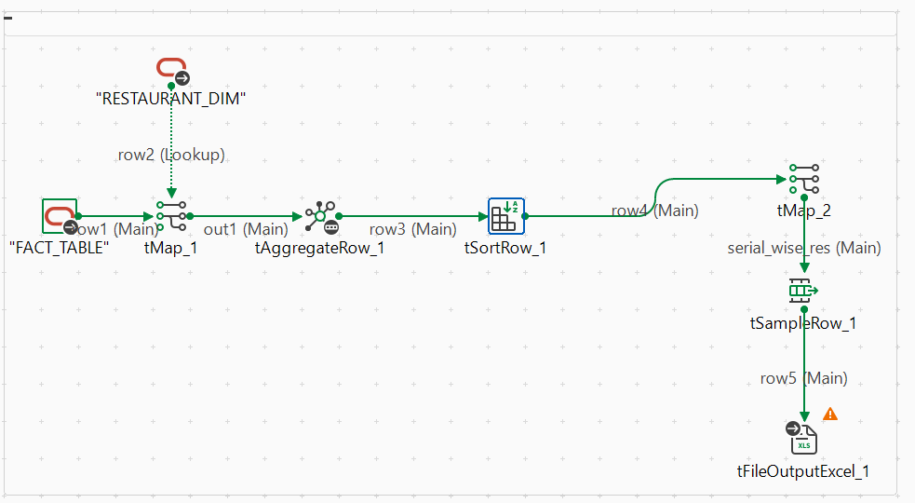
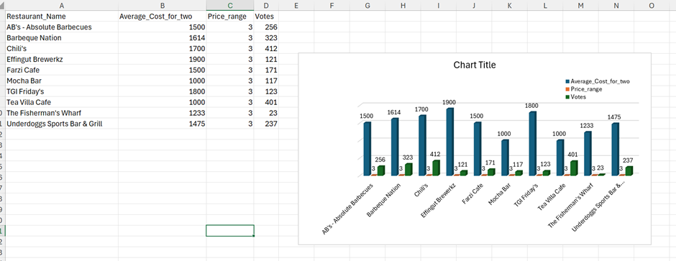
7. Top 10 Restaurants based on Avg cost for two, Avg price range and Avg vote

Slide 14
THANK YOU

